Slide 1
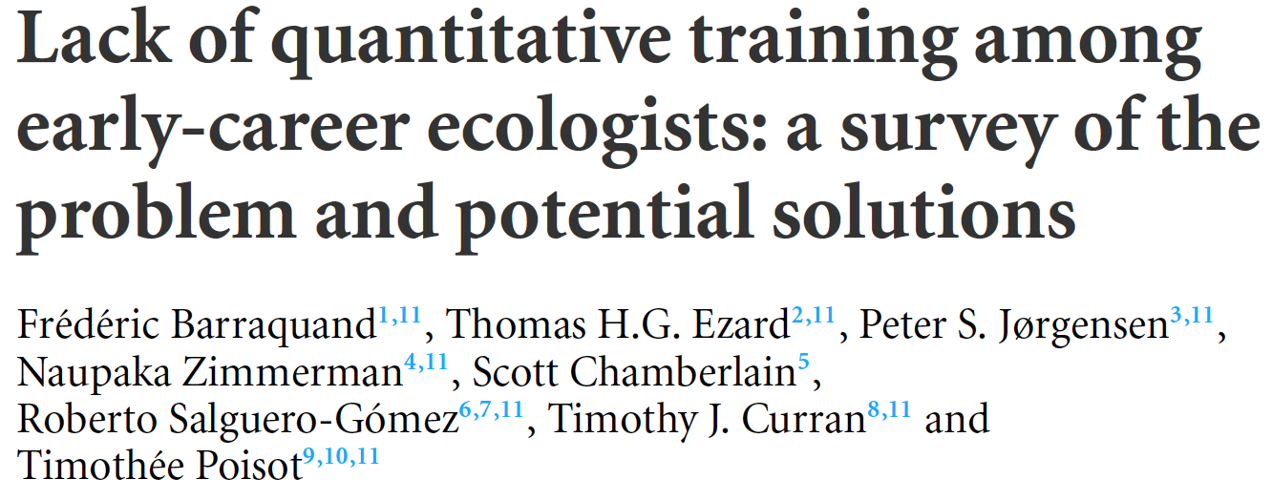
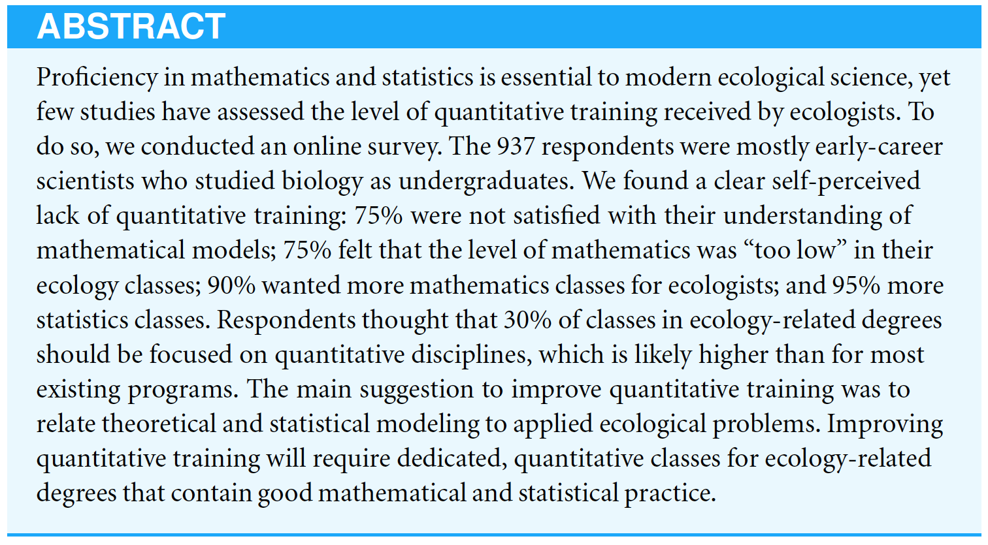

Slide 2

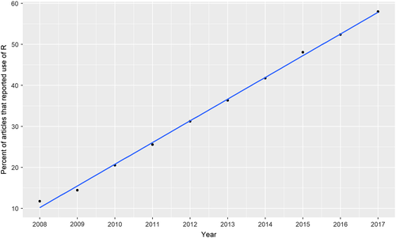
Evaluating the popularity of R in ecology
Lai et al. Evaluating the population of R in ecology. Ecosphere, Volume: 10, Issue: 1, First published: 11 January 2019, DOI: (10.1002/ecs2.2567)
Notes:
The percentage of research articles using R in the 30 main ecology journals from 2008 to 2017. Data were from over 60,000 articles with methods inspected for reported R use.
IF THIS IMAGE HAS BEEN PROVIDED BY OR IS OWNED BY A THIRD PARTY, AS INDICATED IN THE CAPTION LINE, THEN FURTHER PERMISSION MAY BE NEEDED BEFORE ANY FURTHER USE. PLEASE CONTACT WILEY'S PERMISSIONS DEPARTMENT ON PERMISSIONS@WILEY.COM OR USE THE RIGHTSLINK SERVICE BY CLICKING ON THE 'REQUEST PERMISSIONS' LINK ACCOMPANYING THIS ARTICLE. WILEY OR AUTHOR OWNED IMAGES MAY BE USED FOR NON-COMMERCIAL PURPOSES, SUBJECT TO PROPER CITATION OF THE ARTICLE, AUTHOR, AND PUBLISHER.

Slide 3
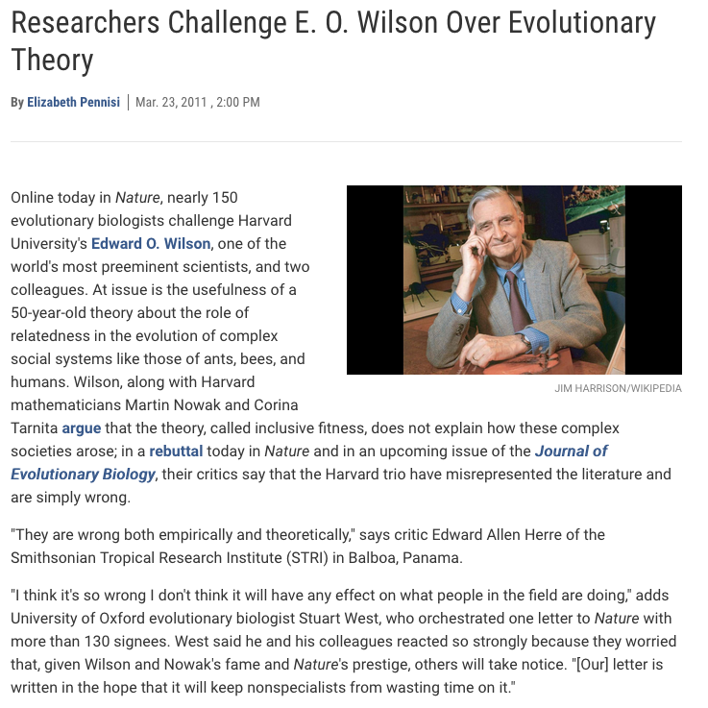

Slide 4

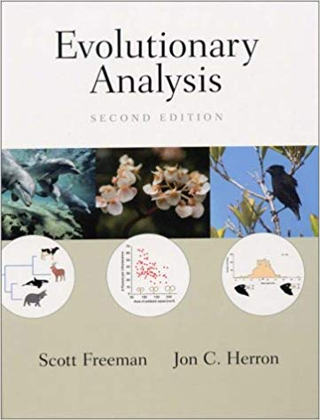
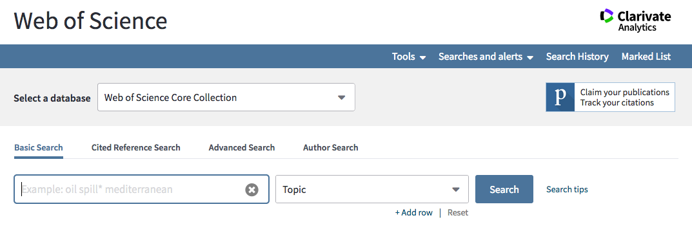

Slide 5
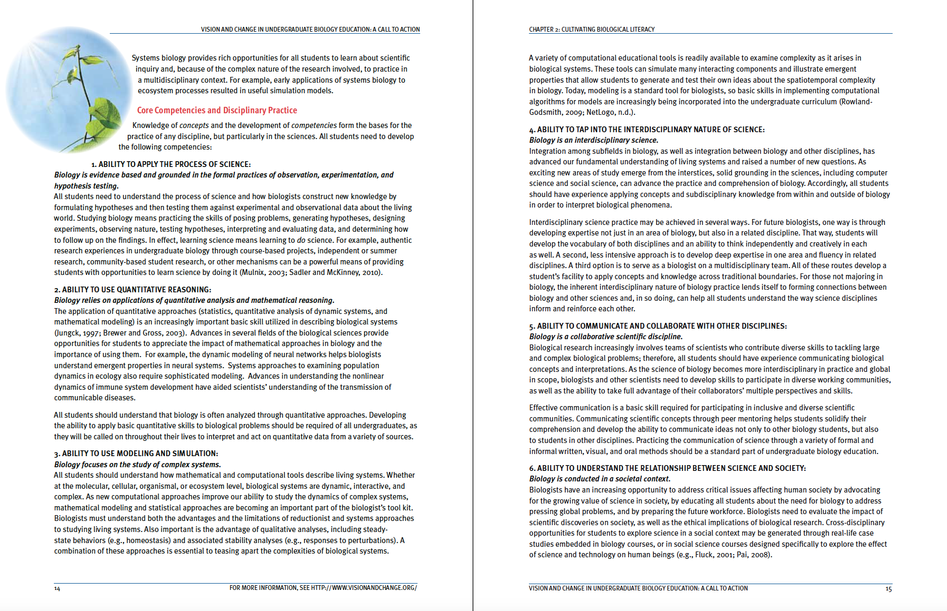

Slide 6

